Slide 1
Course Contents
Sungjoon Choi
(sungjoon.choi@cpslab.snu.ac.kr)

Slide 2
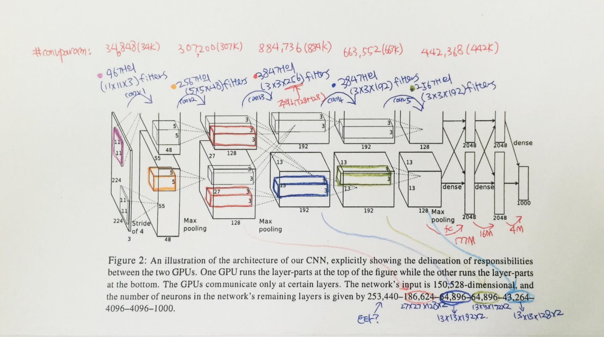
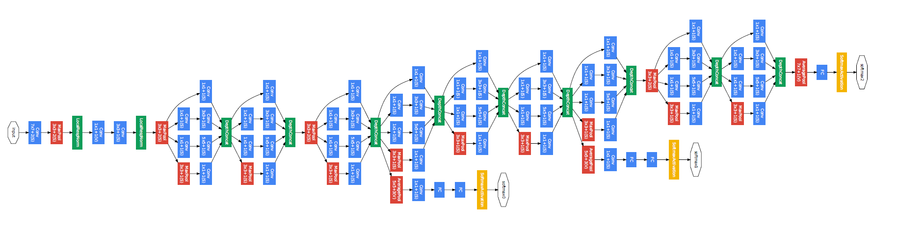
Convolutional neural network
AlexNet
GoogleLeNet

Slide 3
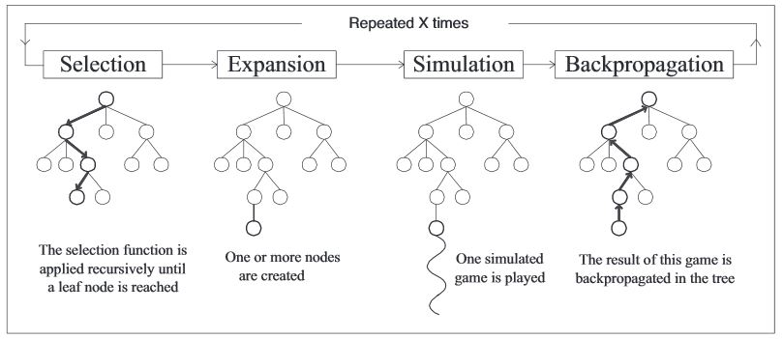
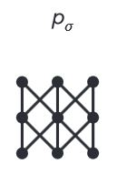
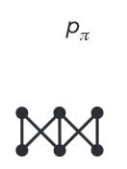
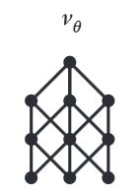
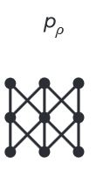
Algorithms behind AlphaGo
Rollout net
Value net
RL net
SL Policy Network

Slide 4

Regularization
Main purpose is to avoid “OverFitting”

Slide 5


Optimization Methods

Slide 6
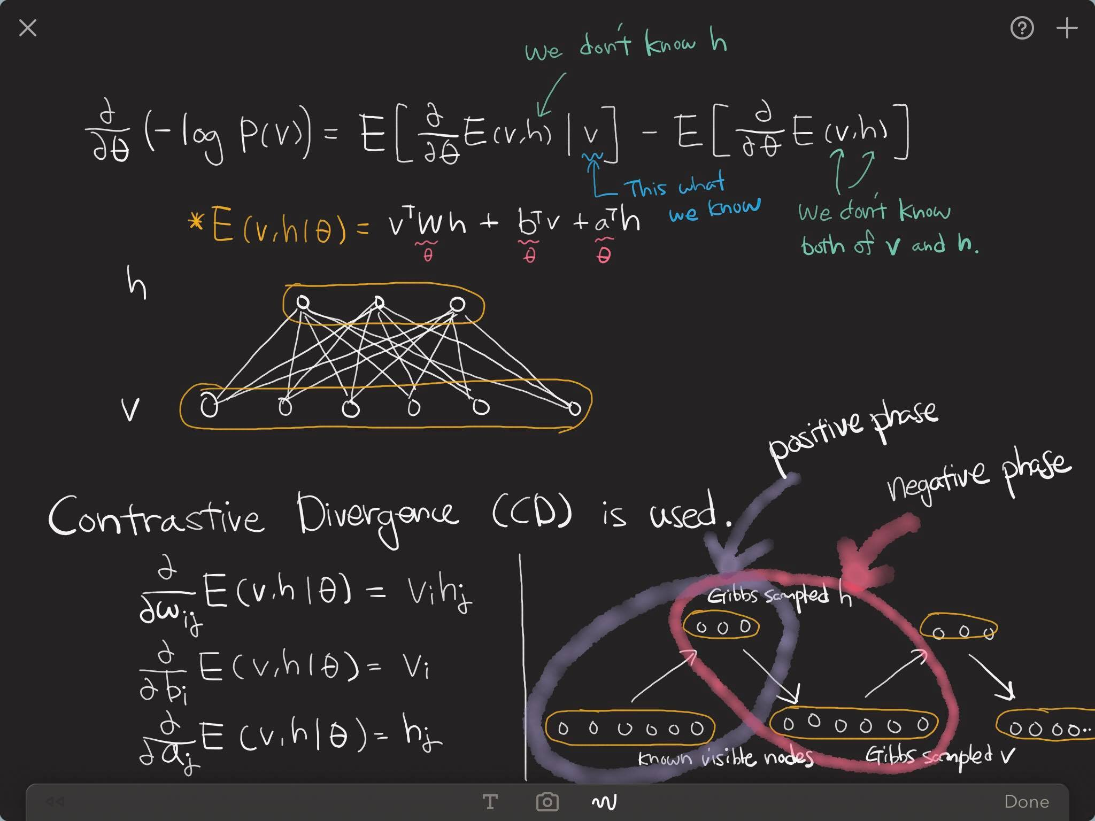
Restricted Boltzmann machine

Slide 7
Denoising Auto-Encoder

Slide 8
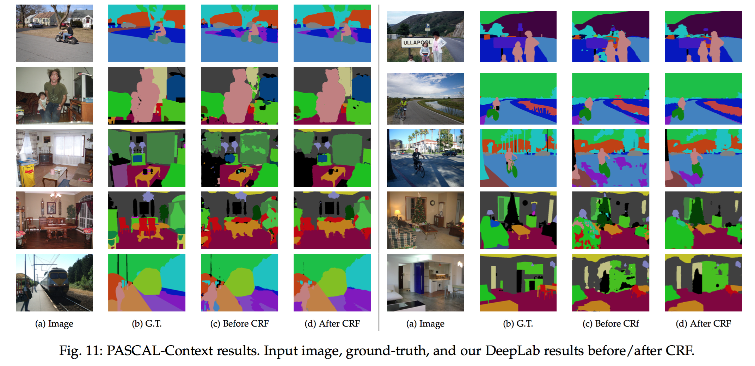
Semantic Segmentation

Slide 9
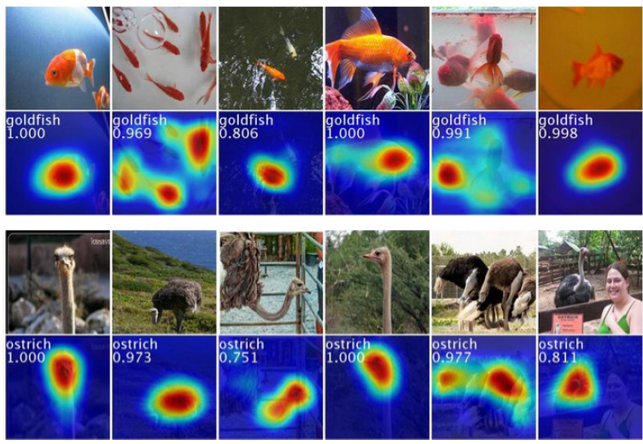
Weakly-Supervised Localization

Slide 10
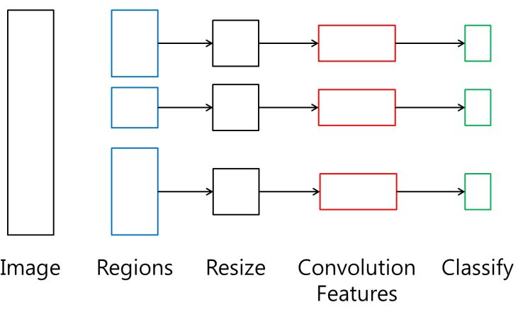
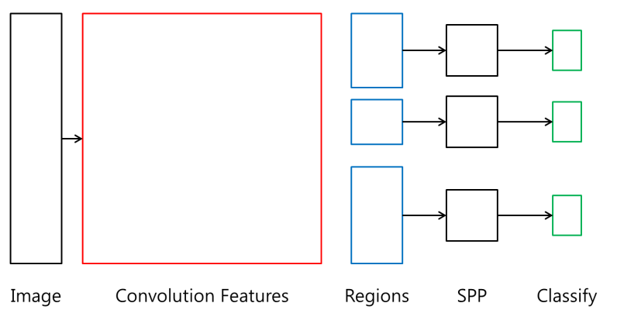
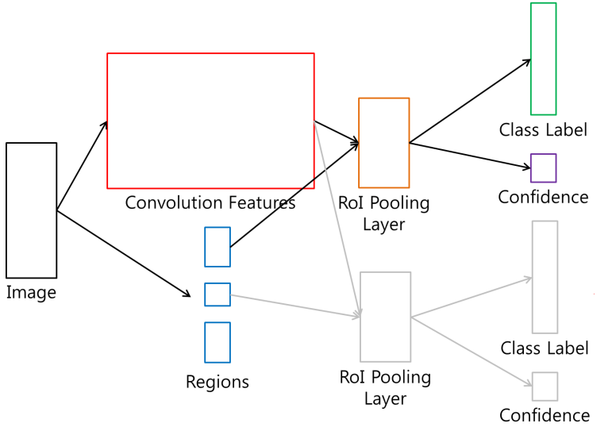
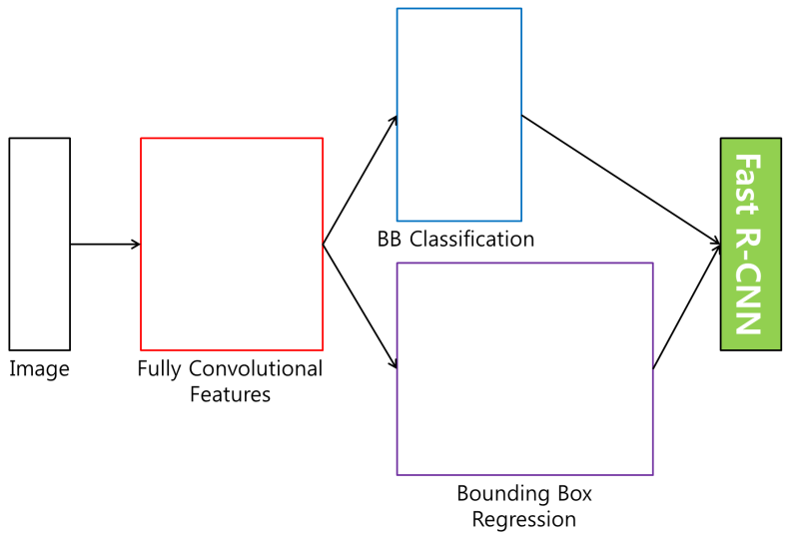
Detection Methods
R-CNN
SPP net
Fast R-CNN
Faster R-CNN

Slide 11

RNN - LSTM
Output
Forget Gate
(Cell) state
Next (Cell) State
Input Gate
Output Gate
Hidden State
Next Hidden State
Input
Output = Hidden state
11
http://colah.github.io/posts/2015-08-Understanding-LSTMs/

Slide 12
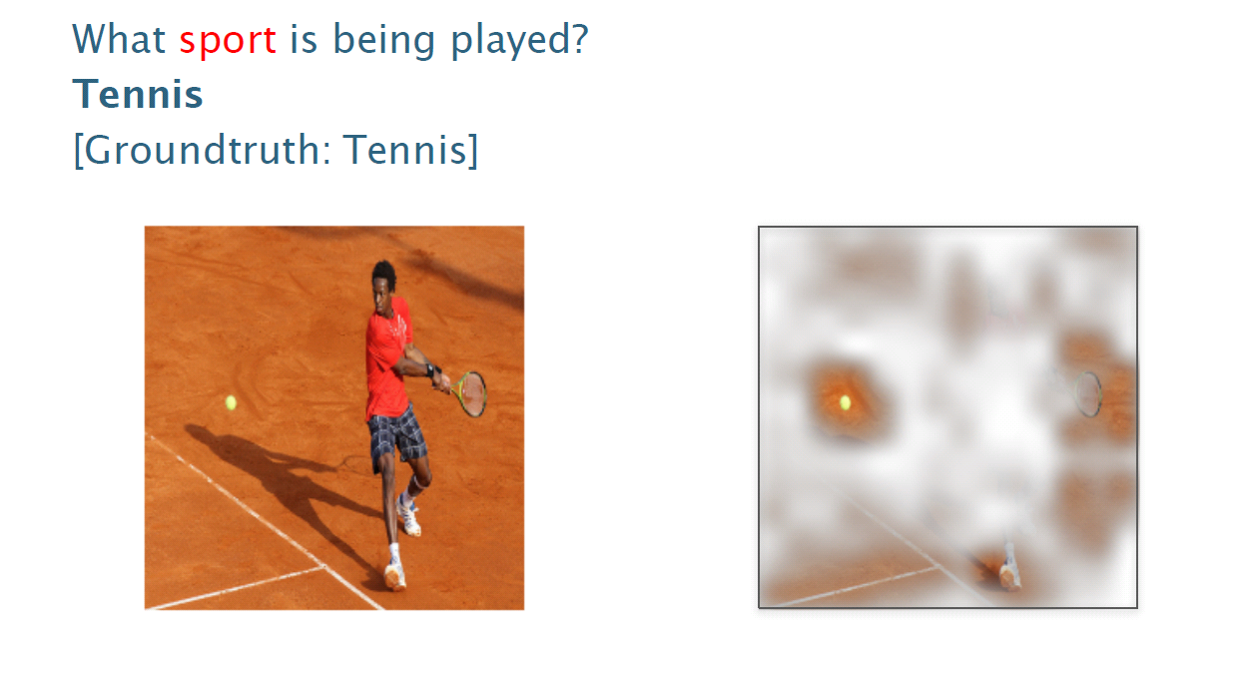
Visual Q&A

Slide 13
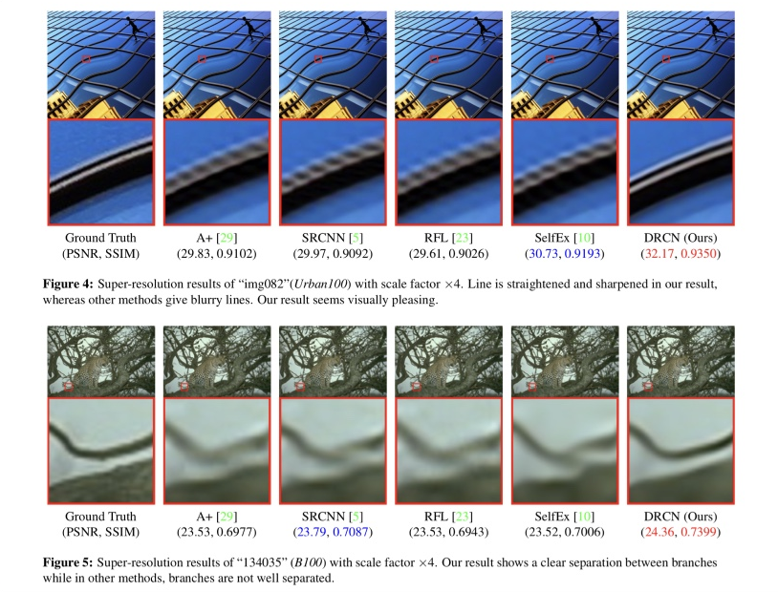
Super Resolution (optional)

Slide 14
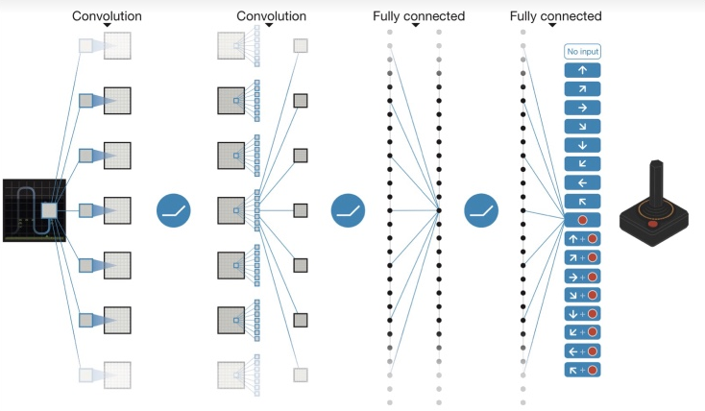
Deep Reinforcement Learning

Slide 15
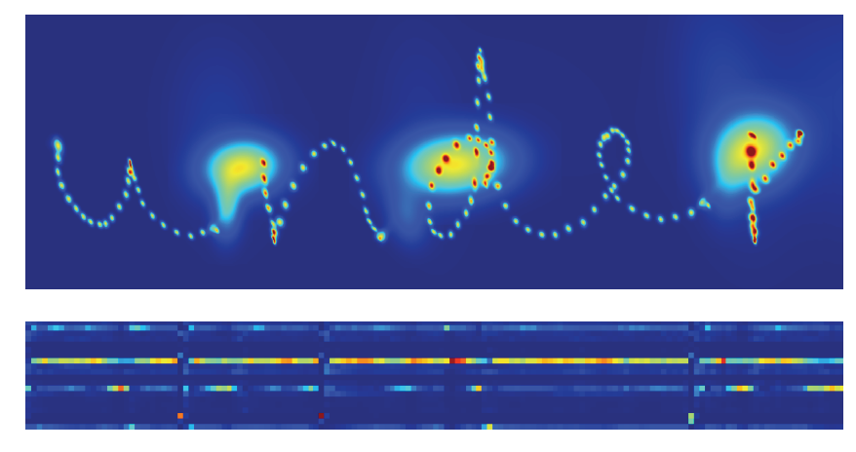
Sequence Generation

Slide 16
Word Embedding

Slide 17
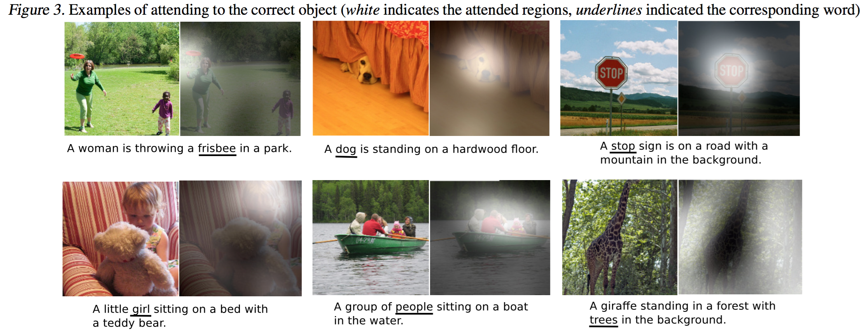
Image Captioning

Slide 18
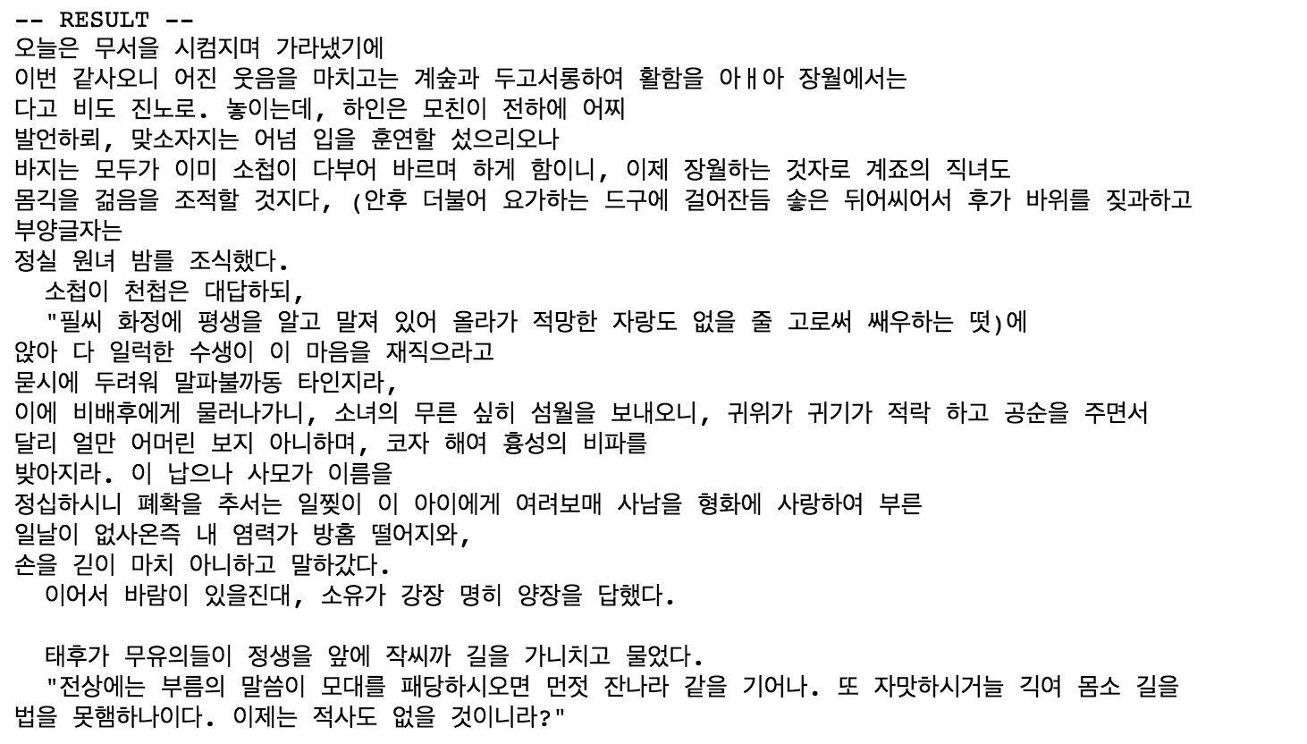
Hangul-RNN (optional)

Slide 19
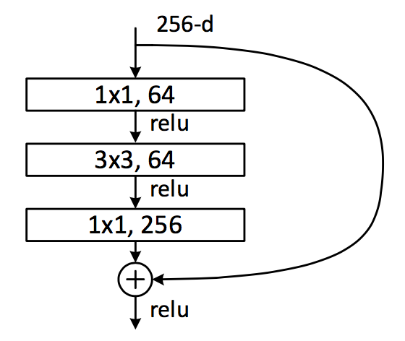
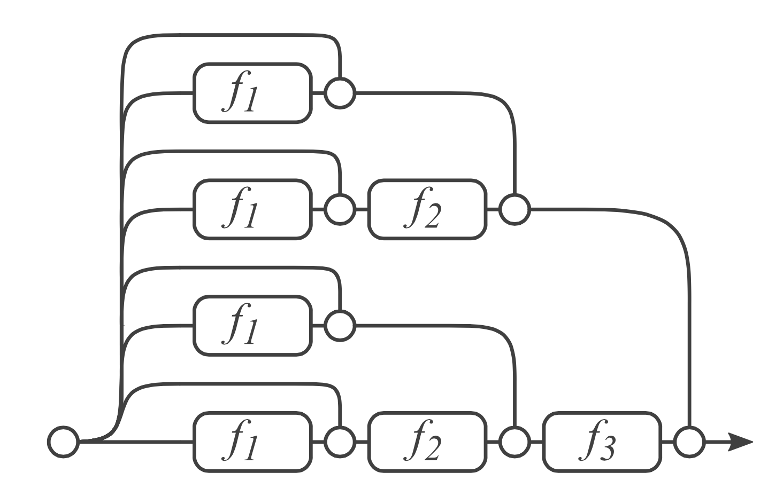
Residual Network & Analyses
Dimension reduction
Convolution
Dimension increasement

Slide 20
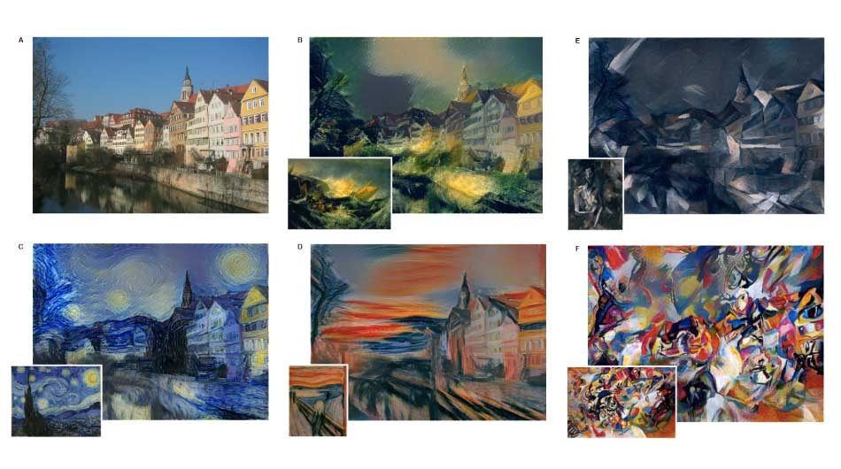
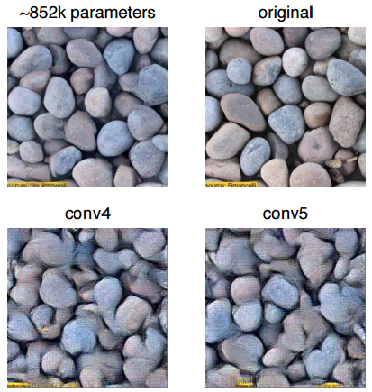
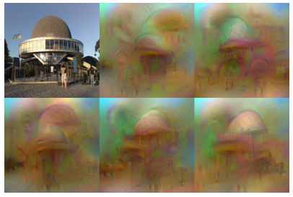
Neural Style (optional)
Texture Synthesis Using Convolutional Neural Networks
NIPS2015
Understanding Deep Image Representations by Inverting Them
CVPR2015

Slide 21
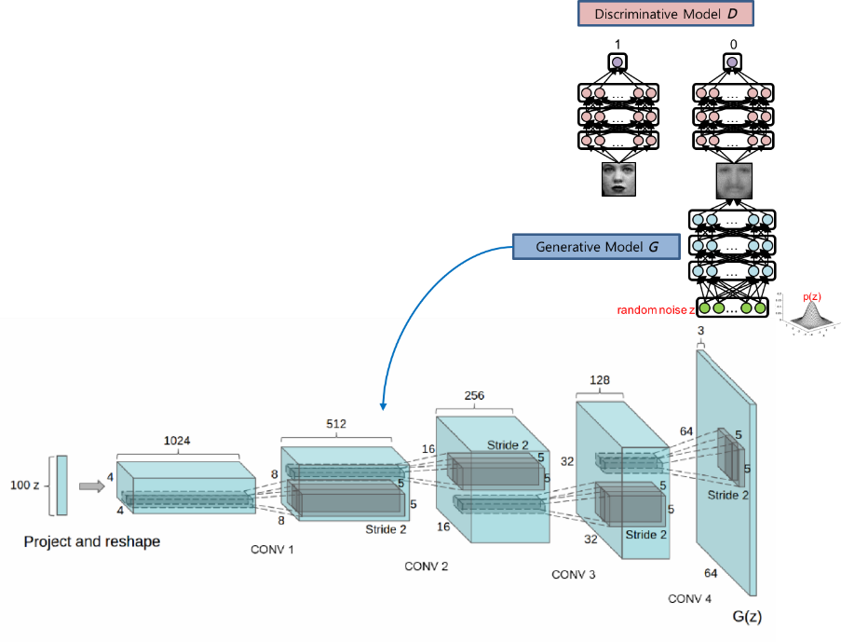
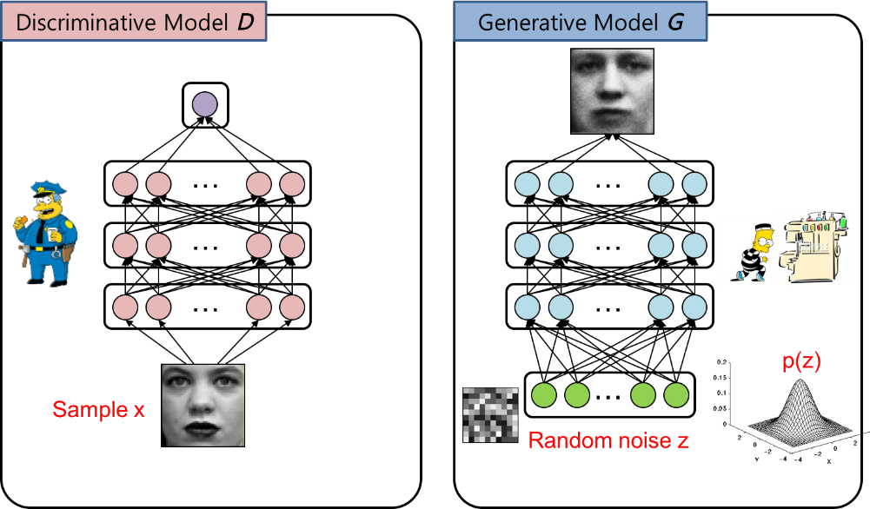
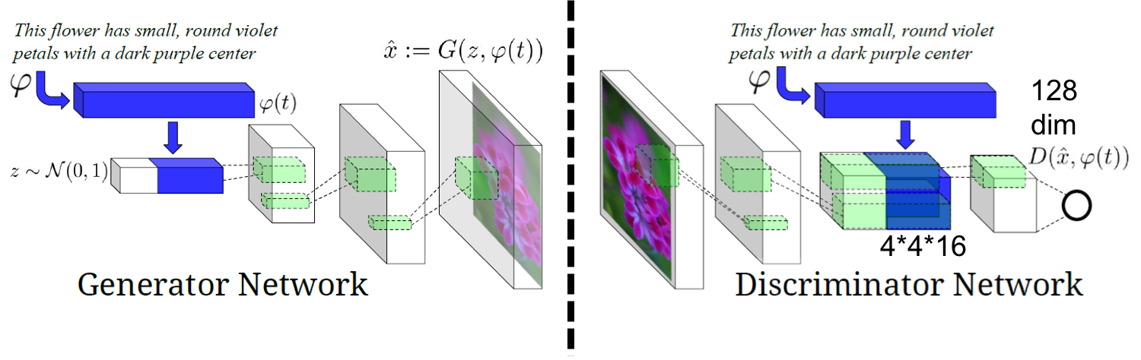
Generative Adversarial Networks

Slide 22
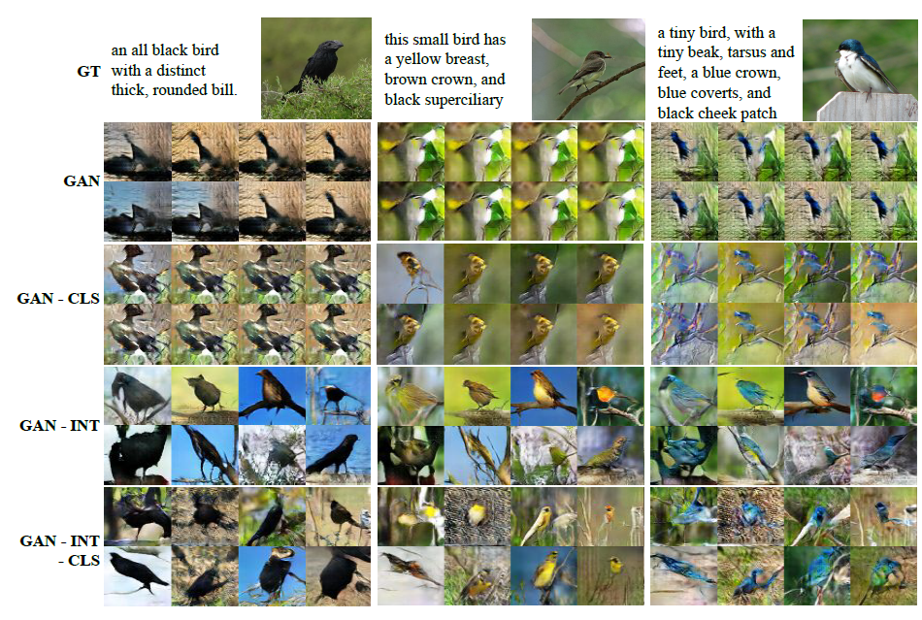
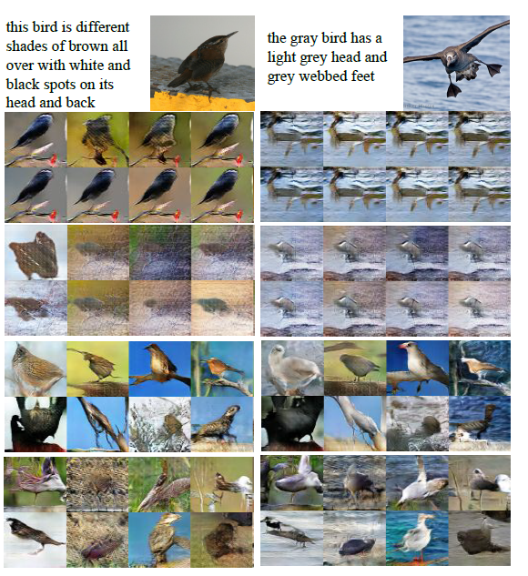
GAN Series

Slide 23
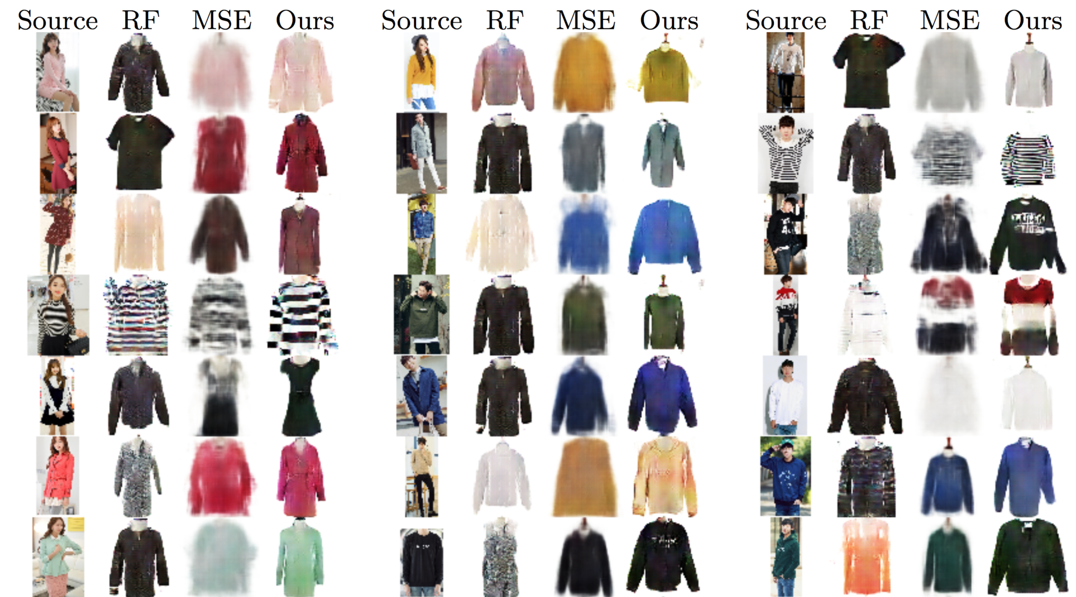
GAN Series

Slide 24
+ Alpha

Slide 25
Codes provided in this course

Slide 26
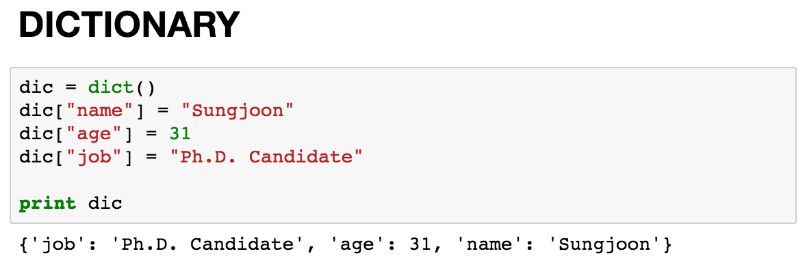
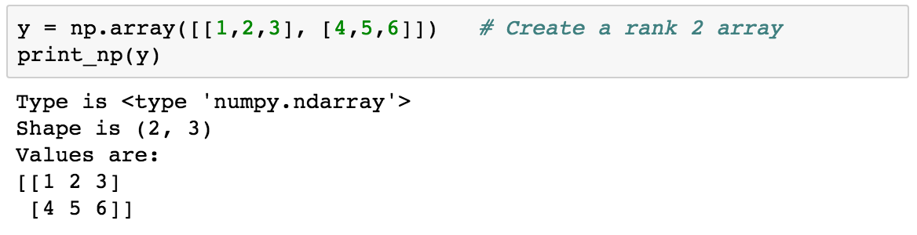
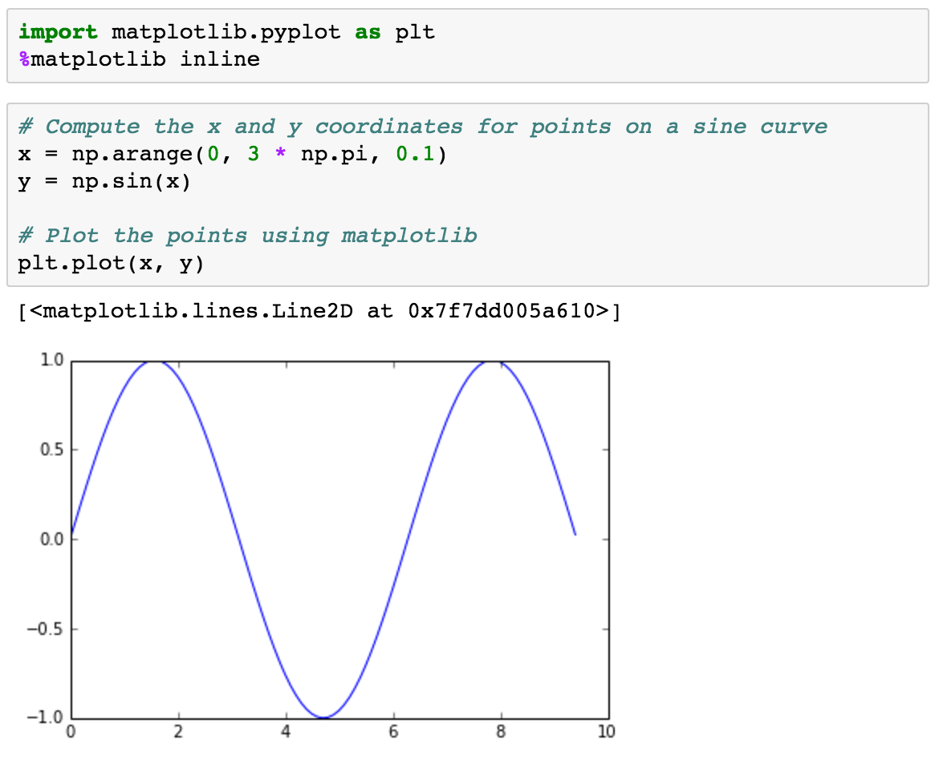
Basic Python

Slide 27
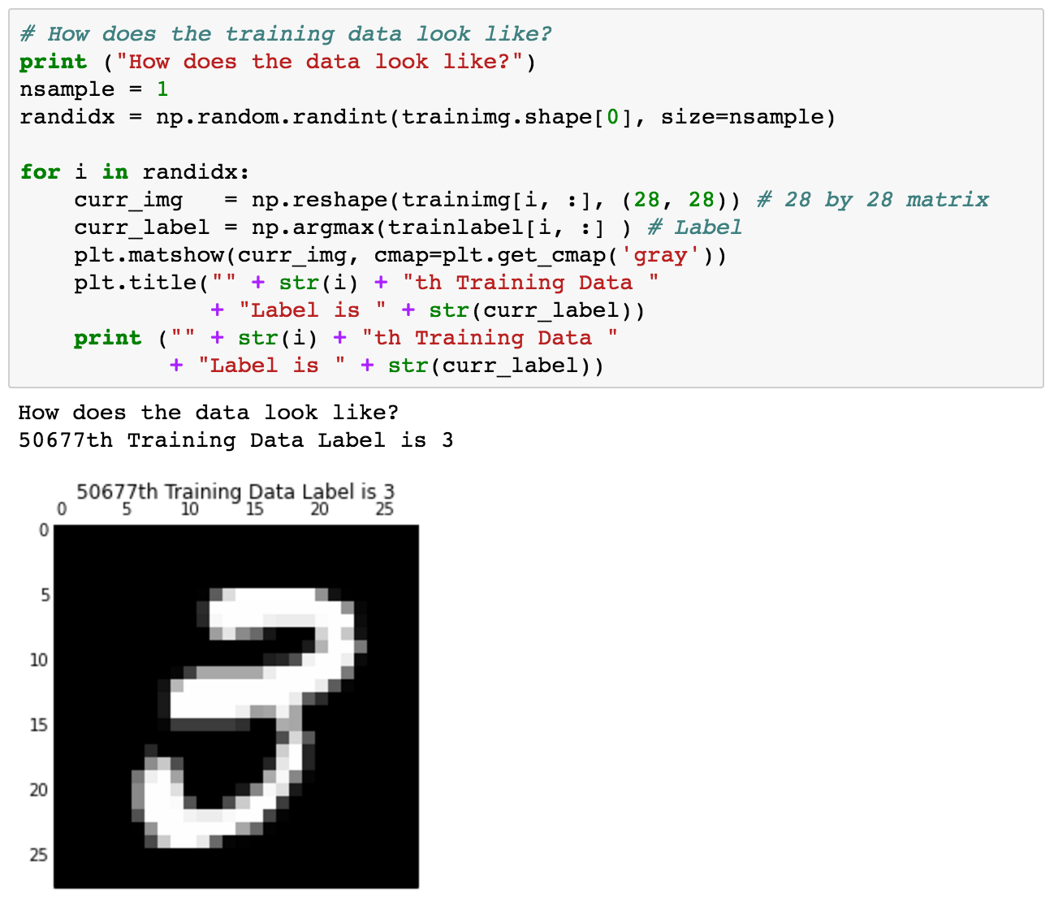
Using MNIST

Slide 28
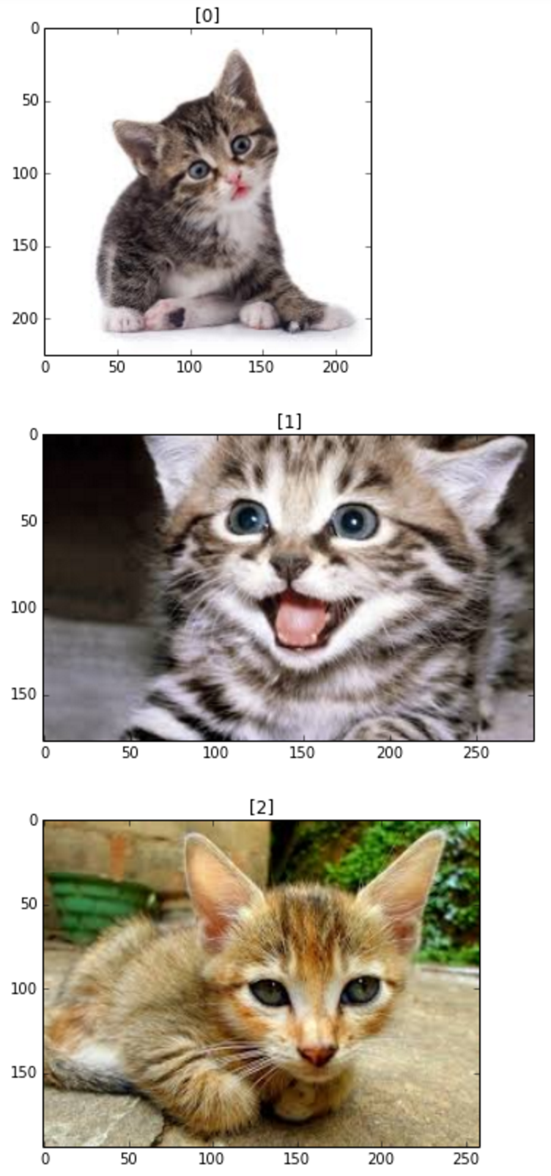
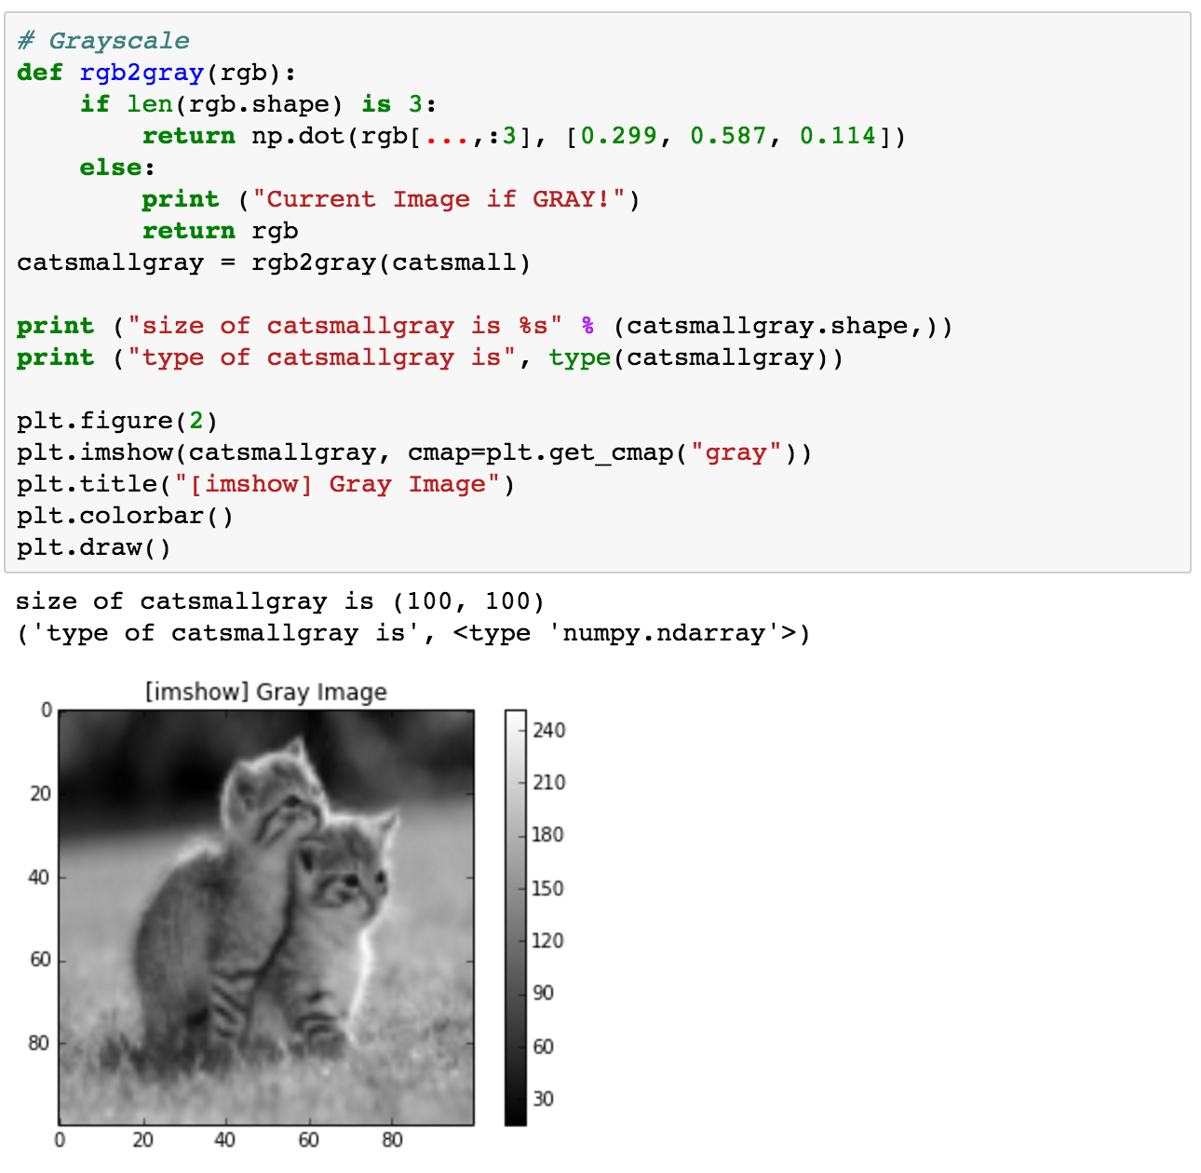
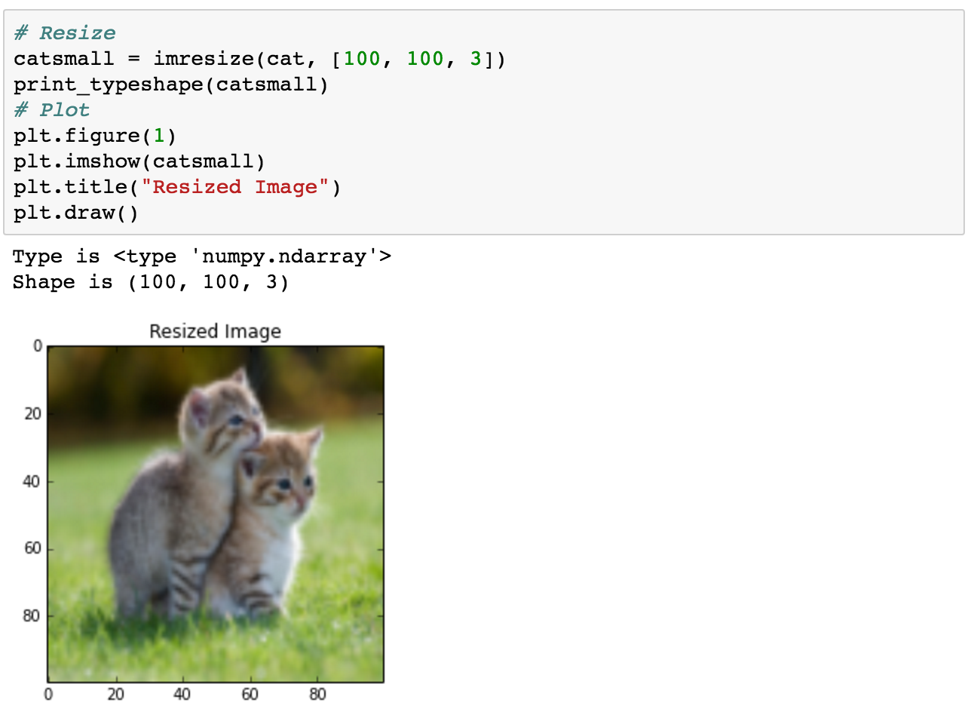
Basic Image Handling

Slide 29
Basic TensorFlow
Computational Graph (TensorFlow)
Optimizer
Loss
Operation
Variable
PlaceHolder

Slide 30
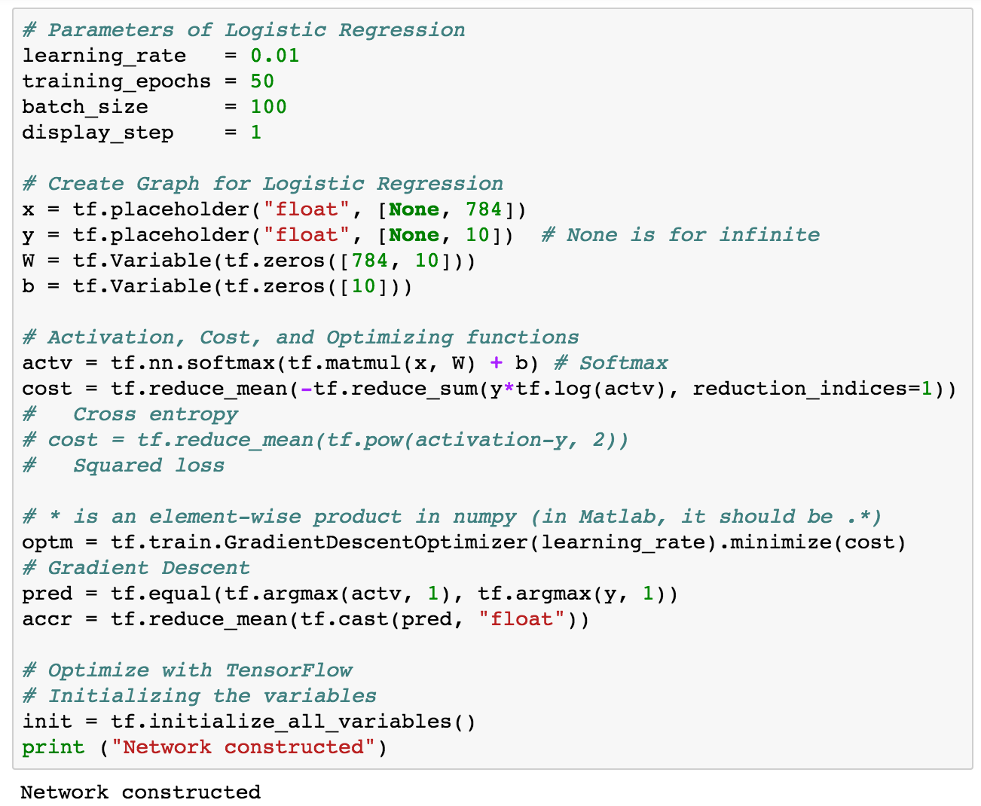
Logistic Regression

Slide 31
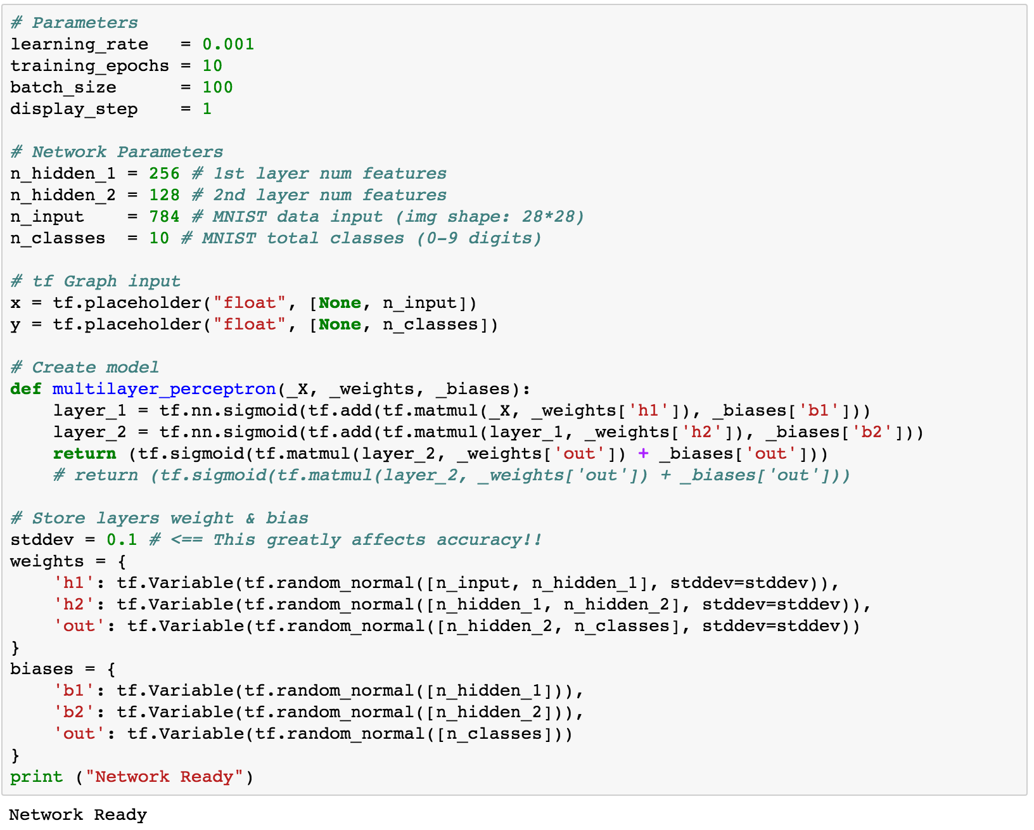
Multi-Layer Perceptron (MLP)

Slide 32
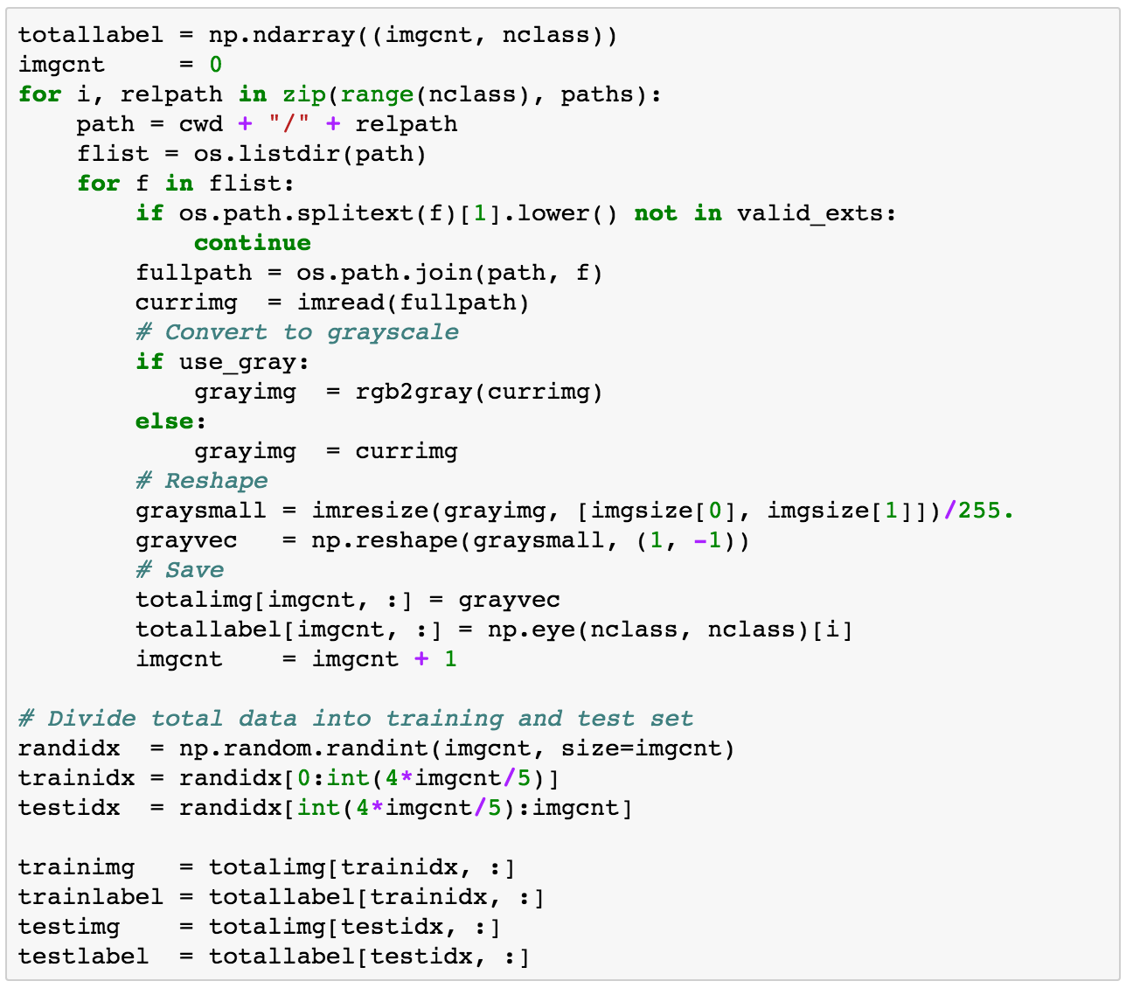
Generating Own Datasets

Slide 33
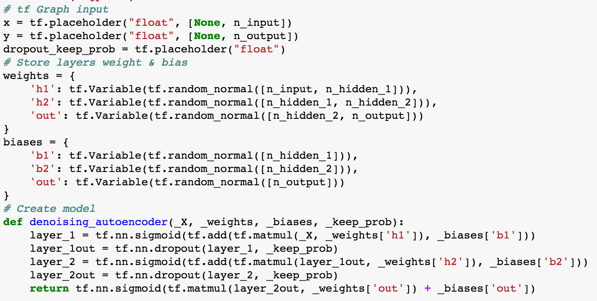
Denoising Auto-Encoder

Slide 34
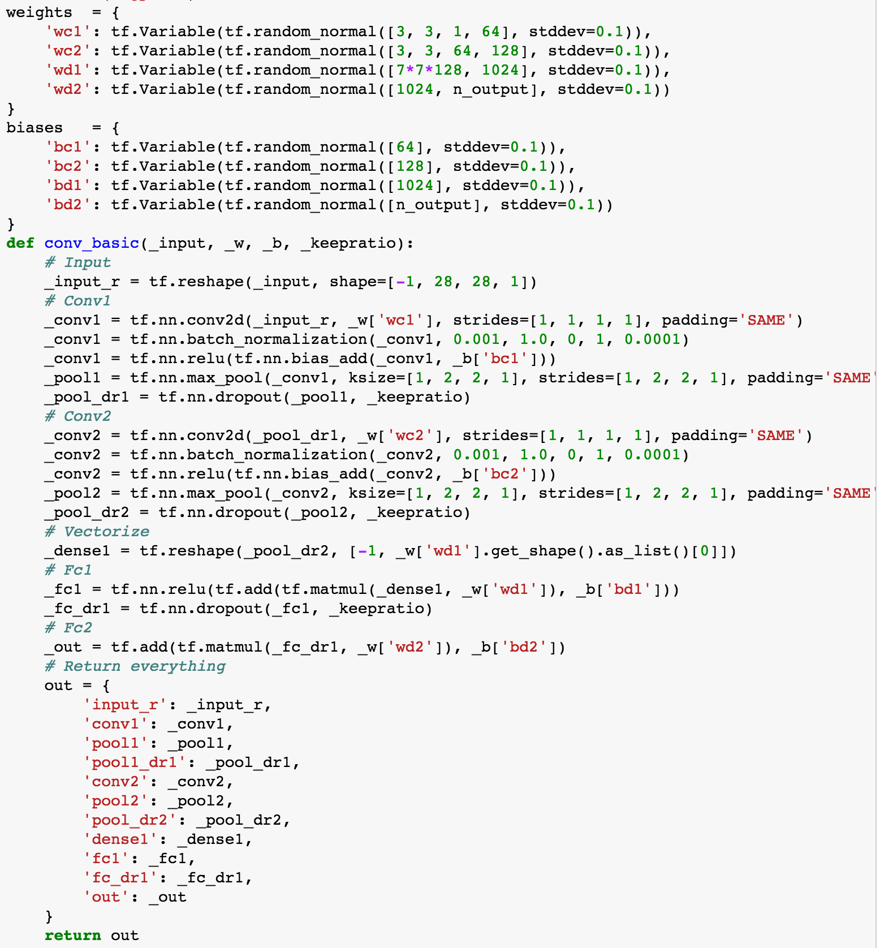
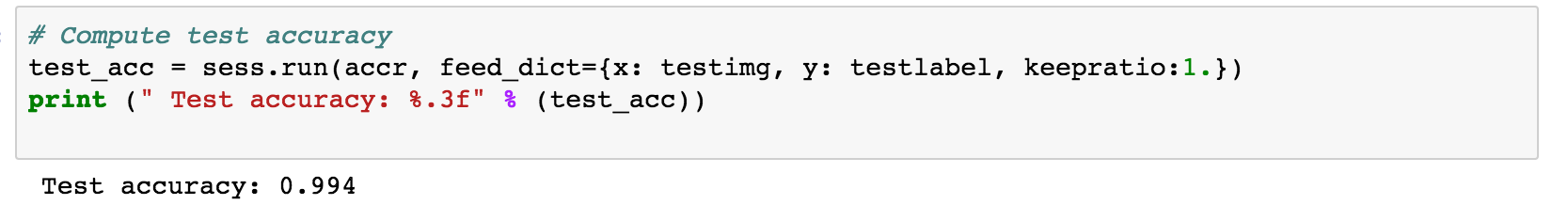
Convolutional Neural Network

Slide 35
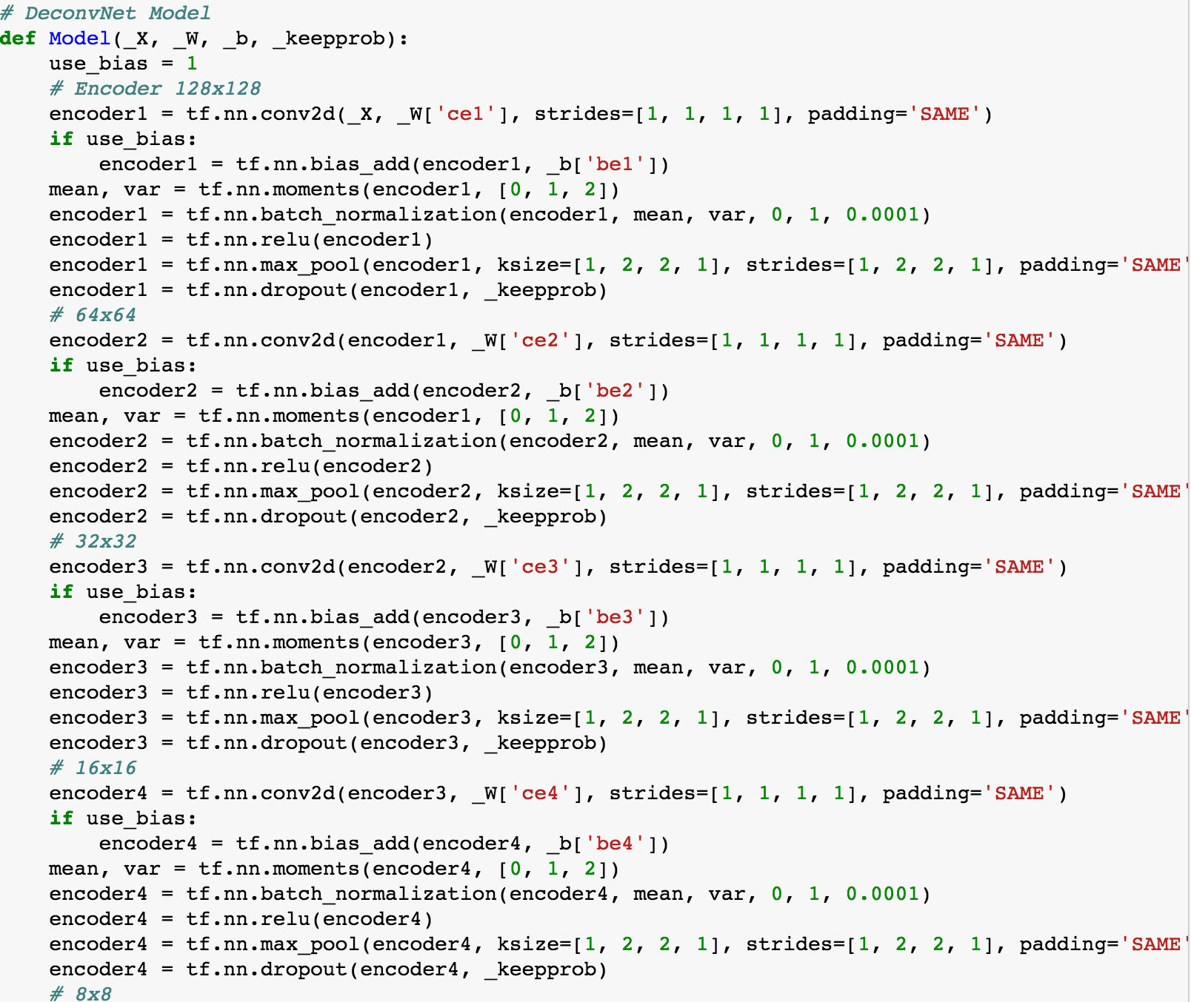
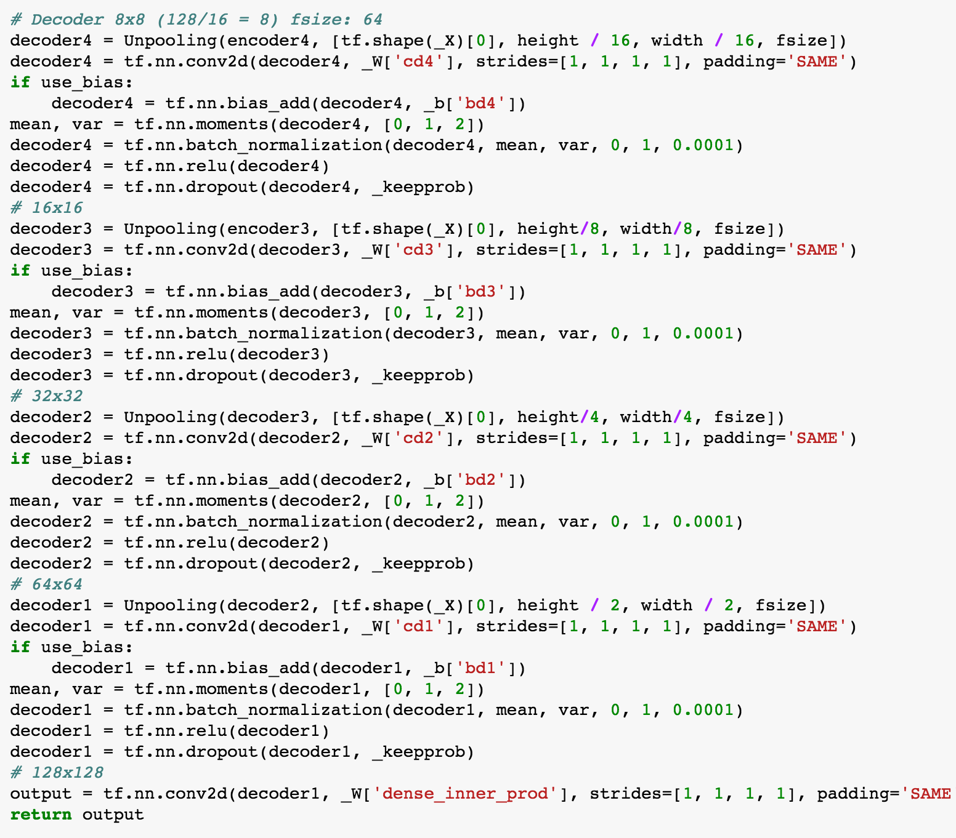
Semantic Segmentation (optional)

Slide 36
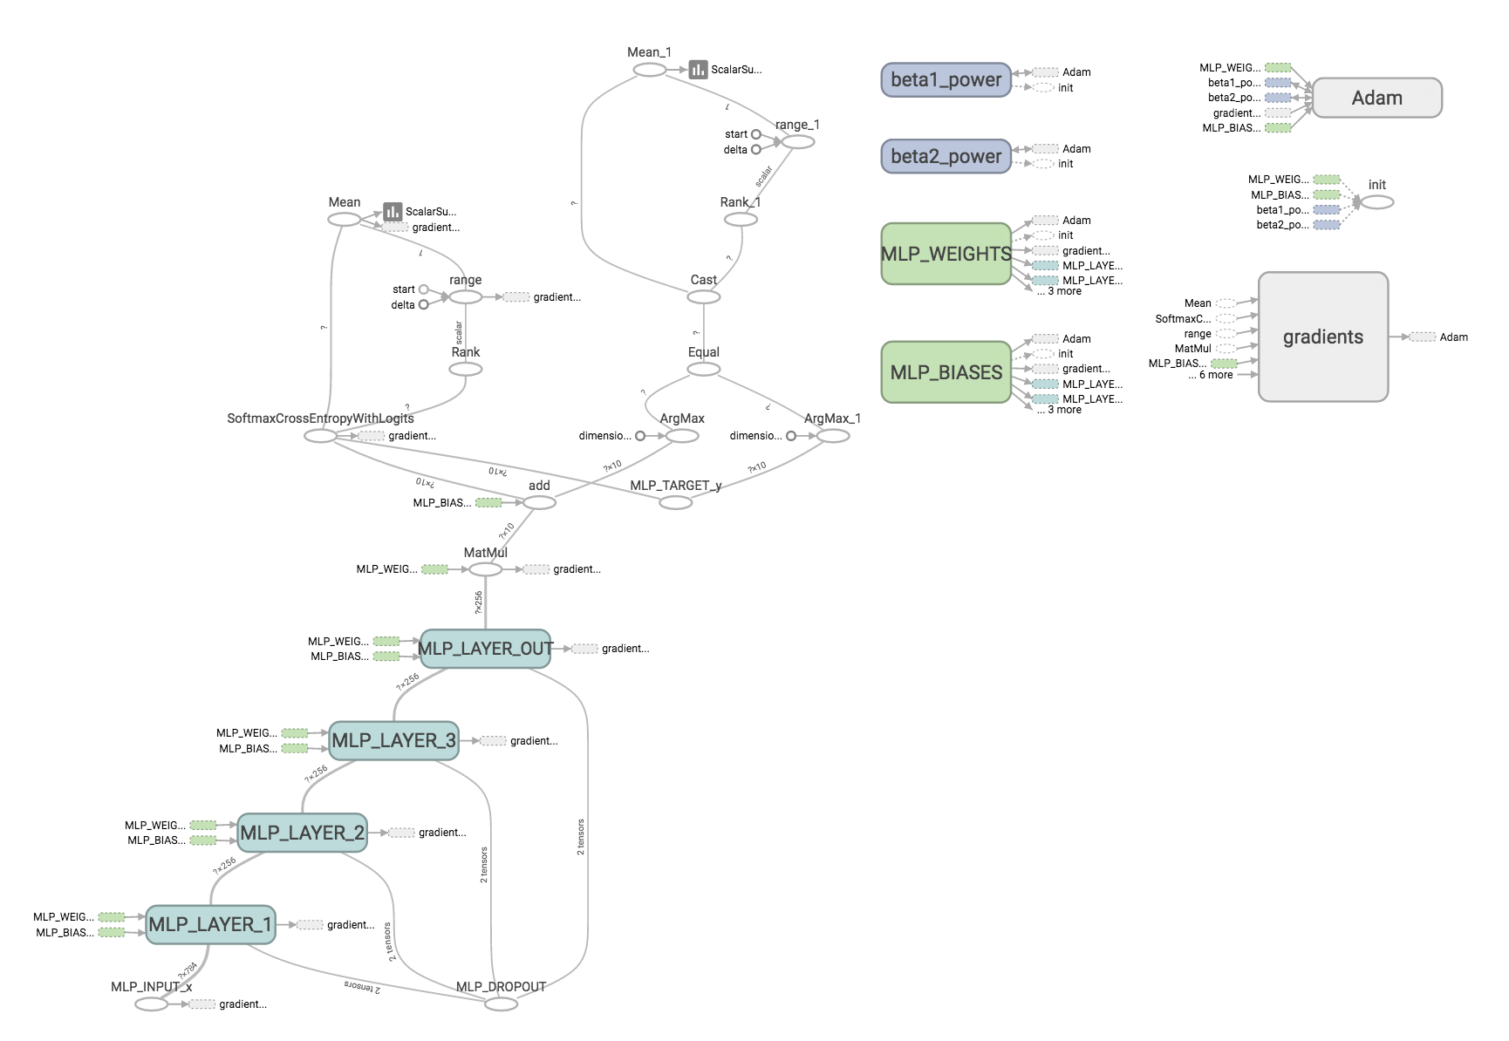
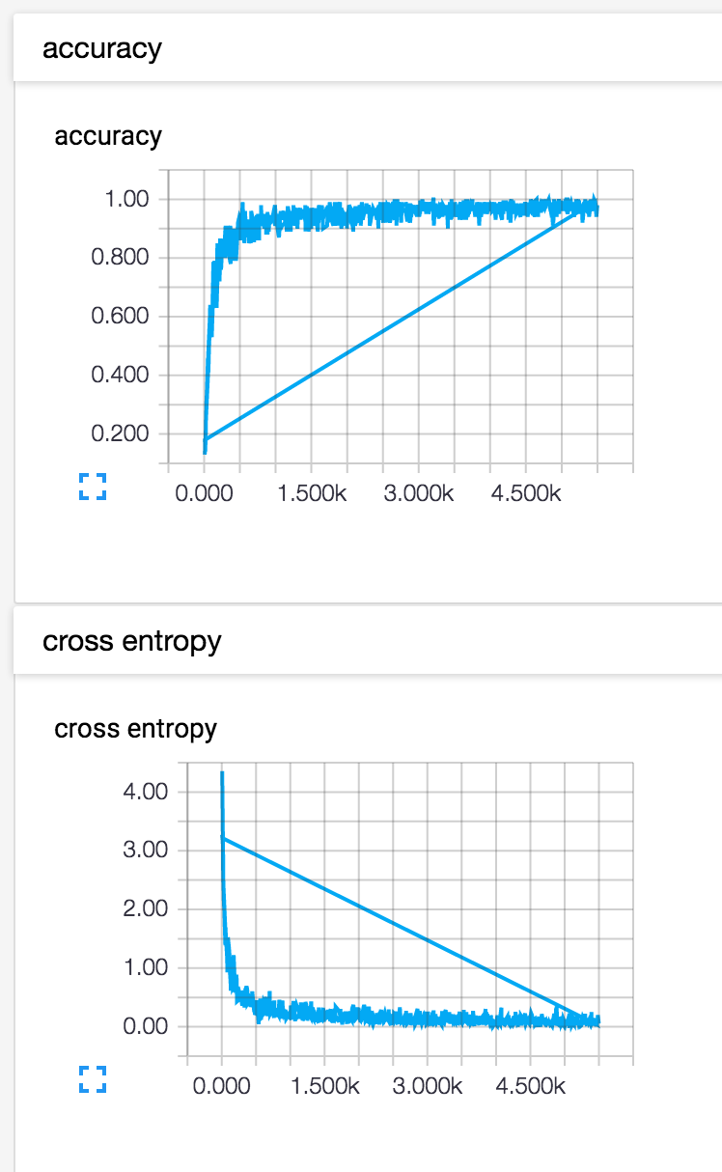
Tensor Board

Slide 37
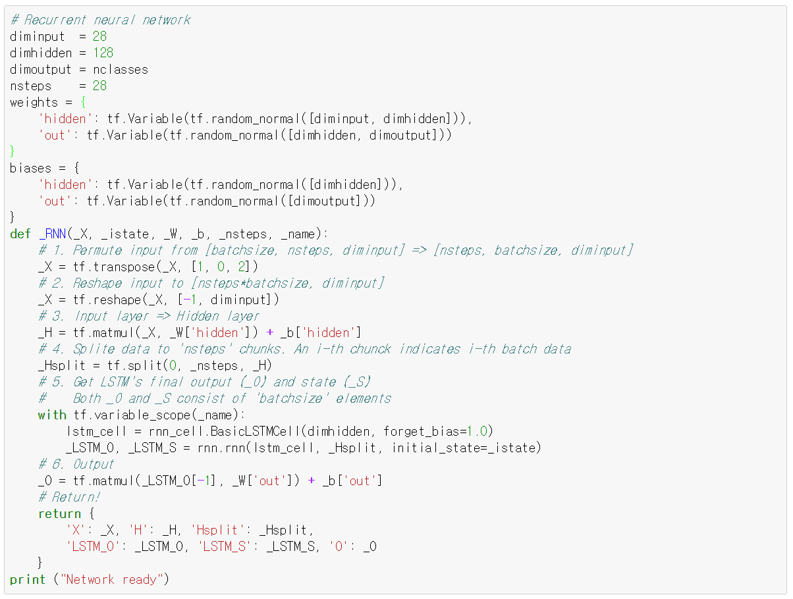
Recurrent Neural Network

Slide 38
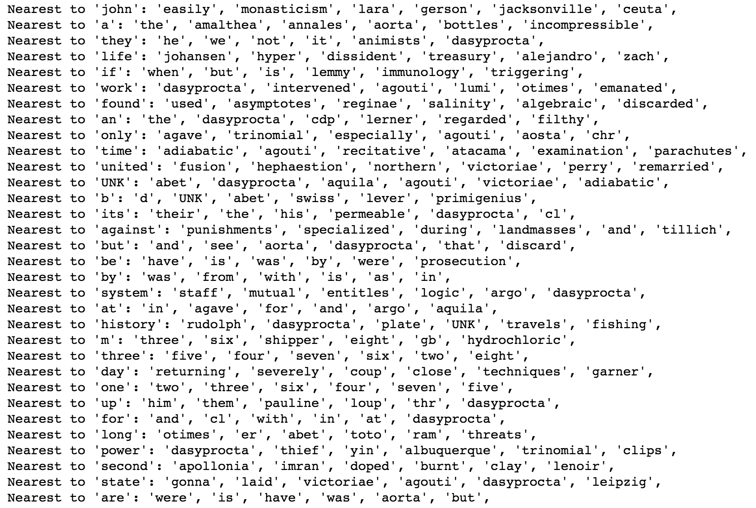
Word2vec

Slide 39

Char-RNN

Slide 40




Neural style (optional)

Slide 41

DCGAN

Slide 42

Mixture Density Network

Slide 43

Domain Adversarial Network

Slide 44

Variational Autoencoder (VAE)

Slide 45

Adversarial Variational Bayes

Slide 46
Advanced Topics This is optional and I would LOVE to discuss about this with YOU!

Slide 47

One-Shot Learning
2016 One-shot Learning with Memory-Augmented Neural Networks
2016 Matching Networks for One Shot Learning

Slide 48

Domain Adaptation
2016 Domain Separation Networks
2016 Domain-Adversarial Training of Neural Networks

Slide 49

Metric Learning
2015 DEEP METRIC LEARNING USING TRIPLET NETWORK
2016 Deep Metric Learning via Lifted Structured Feature Embedding

Slide 50

Memory Network
2016 Hybrid computing using a neural network with dynamic external memory

Slide 51

Other Interesting Papers
2016 Learning without Forgetting
2016 Unsupervised Learning for Physical Interaction through Video Prediction

Slide 52

Uncertainty in Neural Networks

Slide 53


+ a Hell of a Lot More!

